Slide 1
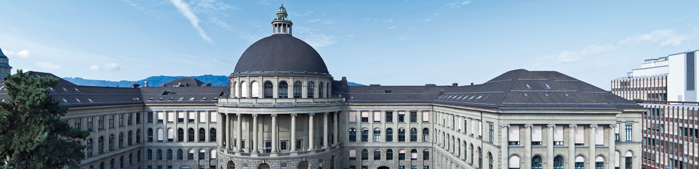
Neural Style Transfer for Ultrasound Imaging
Davide Menini
Supervisor: Prof. Orcun Goksel
Advisors: Lin Zhang, Dr. Tiziano Portenier

Slide 2
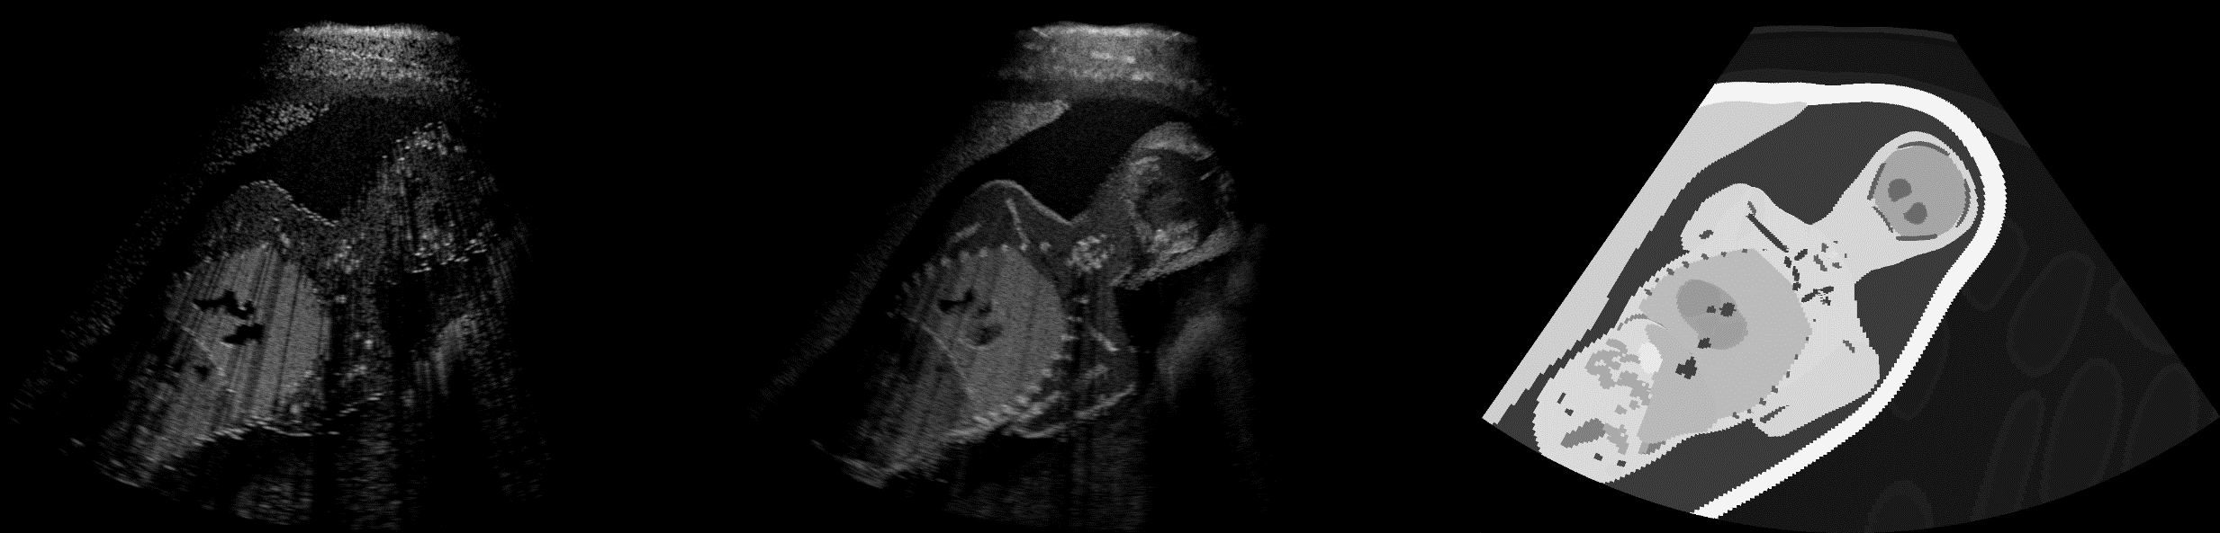
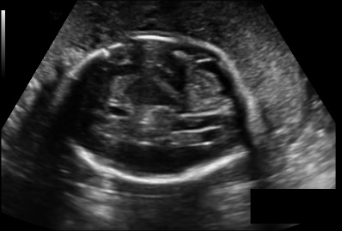
Motivation
Simulation of US images is fundamental for the training of specialized medical personnel
Research goal: produce images indistinguishable from real ones in real-time
Simulated images are accurate but still not completely realistic
Our goal: increase quality and realism via Neural Style Transfer
Simulated LQ Image ^{[5]}
Simulated HQ Image ^{[5]}
Real Clinical US Image ^{[6]}
NST
NST

Slide 3
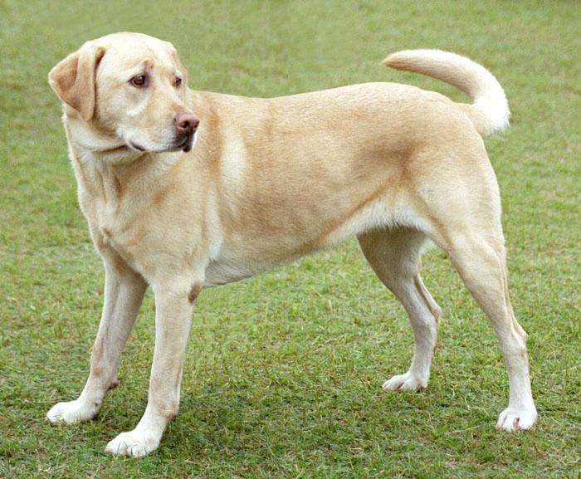
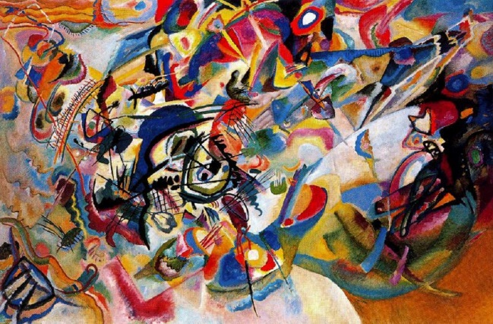
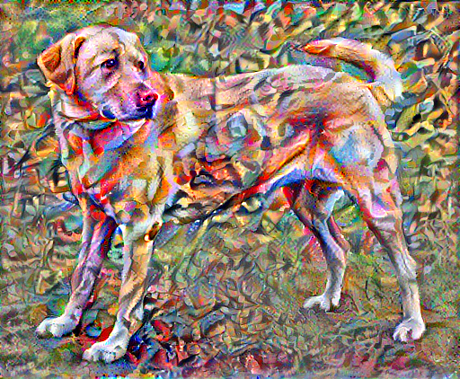
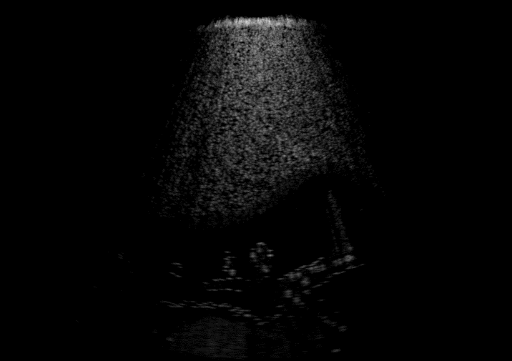
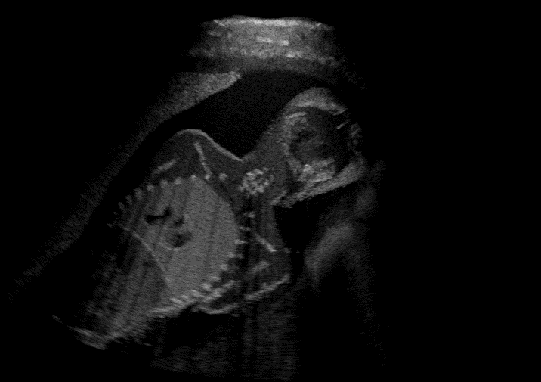
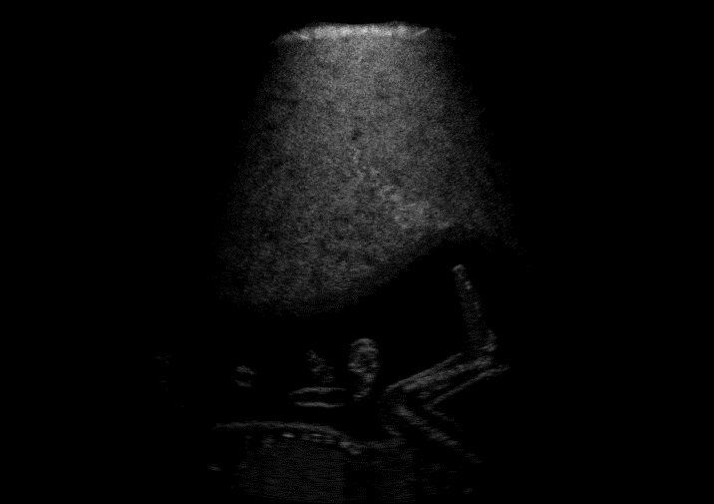
Neural Style Transfer for US Imaging
Content Image
Style Image
Stylized Image

Slide 4



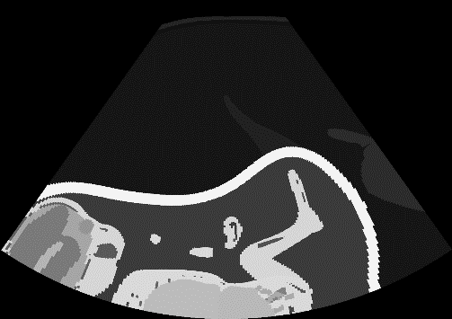
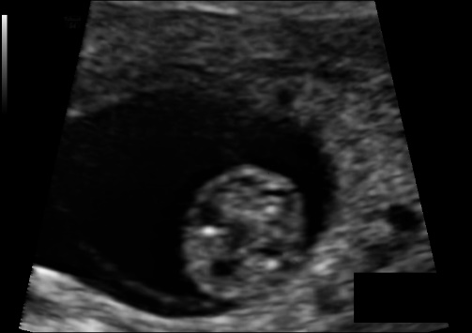

Tasks
Content
Style
Target
Metrics
Low-quality
to
High-quality
SSIM, PSNR
Segmentation to
High-quality
SSIM, PSNR
High-quality
to
Clinical
FID

Slide 5
Thesis Overview
Optimization approach
Neural Style Transfer
Augmented Style Loss
Local Style Transfer
Average style in feature space
Learning approach
Perceptual Loss network
Noise Injection
Average style in feature space

Slide 6

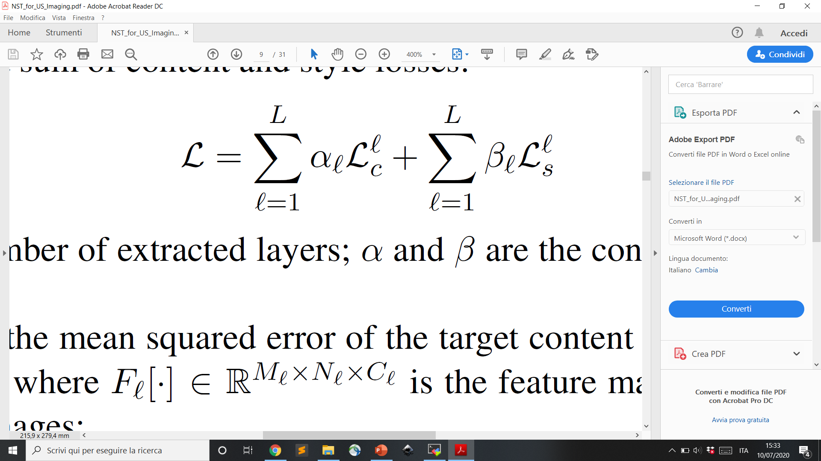
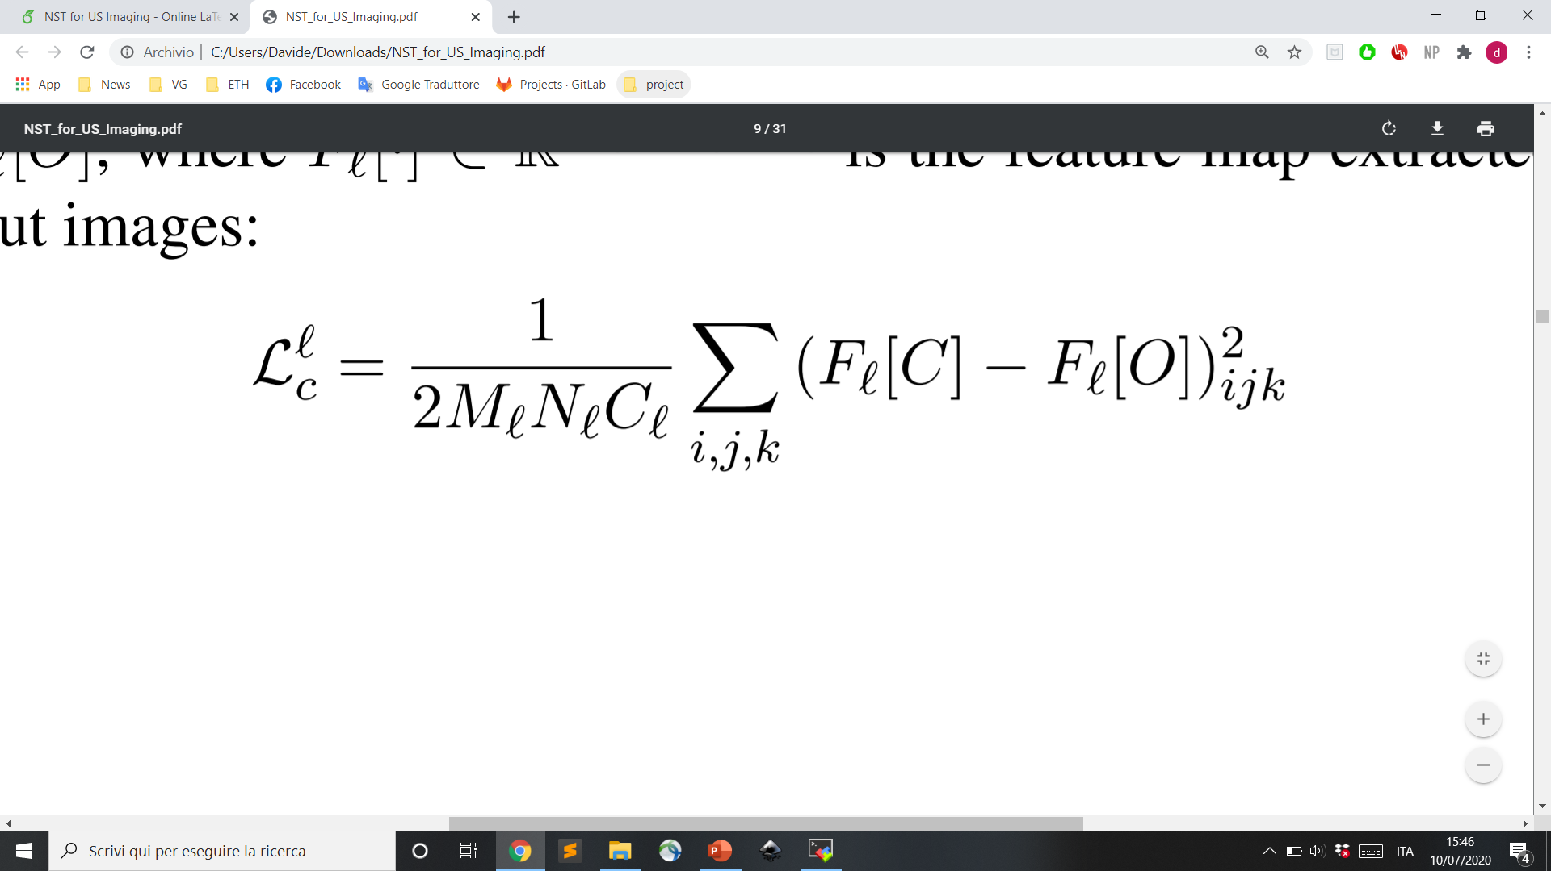
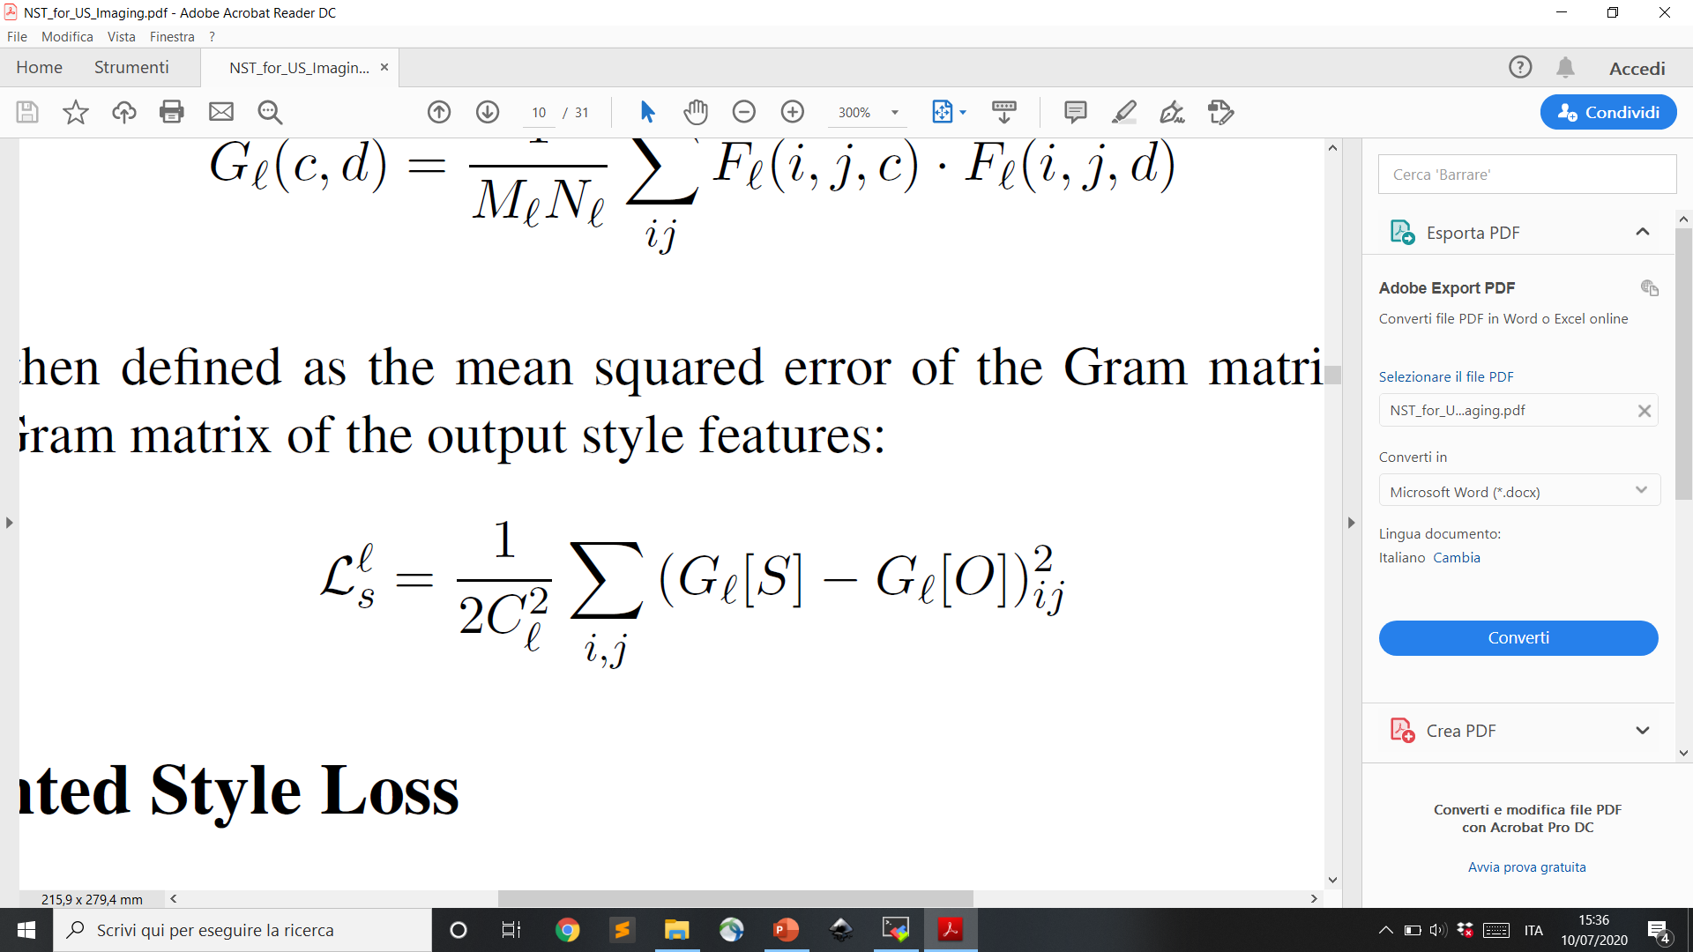
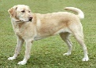

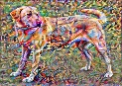
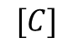
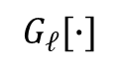
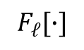
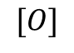
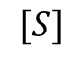
Neural Style Transfer (NST)
*
20 min
Optimization approach
Neural Style Transfer ^{[1]}
Augmented Style Loss
Local Style Transfer
Average style in feature space
Minimize:
Content loss
Style loss
Learning approach
Perceptual Loss network
Noise Injection
Average style in feature space
VGG-19
$$[C]$$
$$[S]$$
$F_{ℓ}[∙]$
$G_{ℓ}[∙]$
$$[O]$$
* 3000 iterations on Titan X

Slide 7
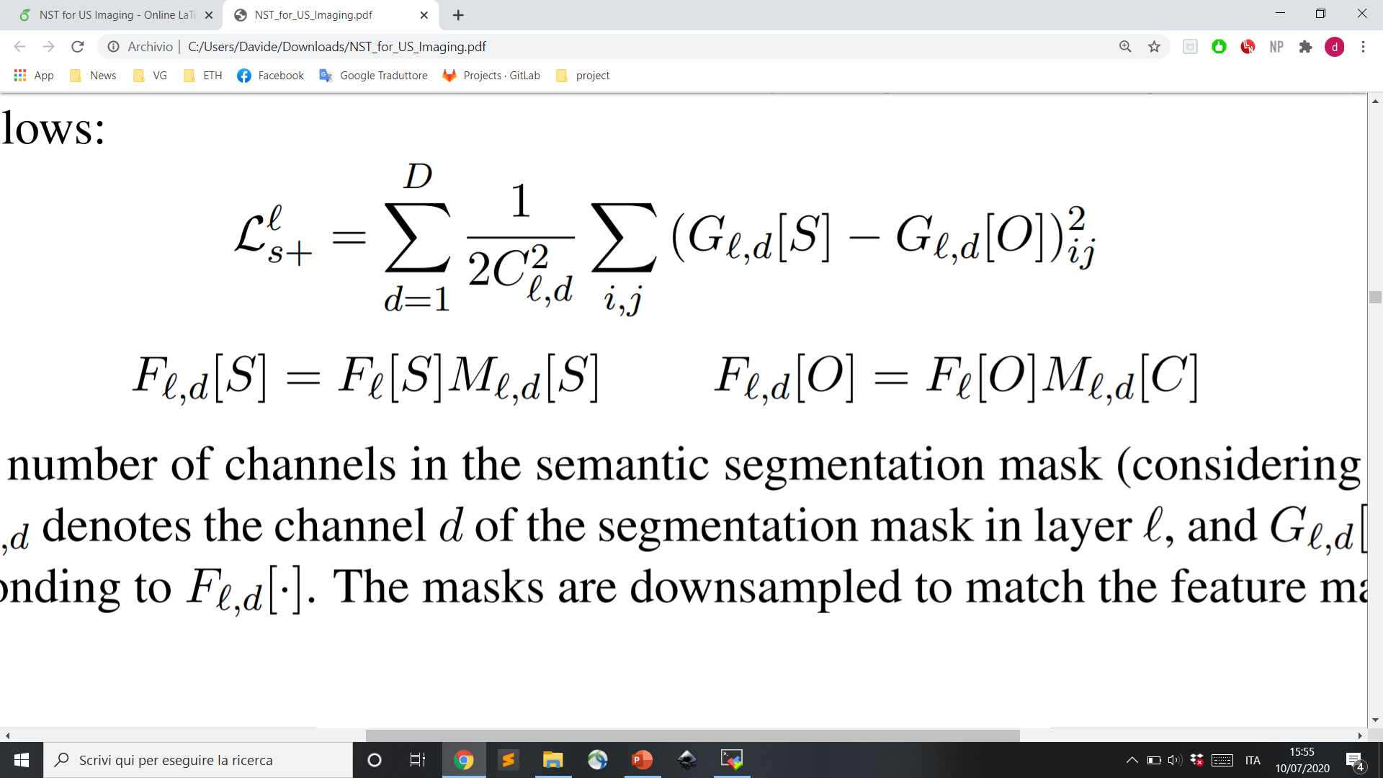
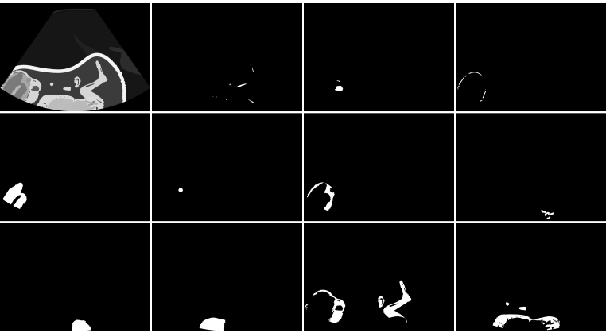
NST with Augmented Style Loss
*
25-75 min
Optimization approach
Neural Style Transfer
Augmented Style Loss ^{[2]}
Local Style Transfer
Average style in feature space
Style loss updated with semantic info from masks:
Learning approach
Perceptual Loss network
Noise Injection
Average style in feature space
* 3000 iterations on Titan X, timing depends on the amount of masks (1 to 10)

Slide 8
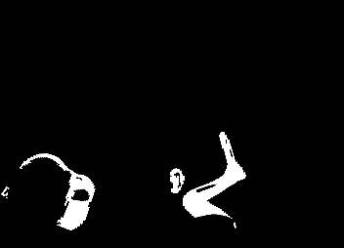
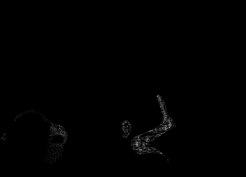


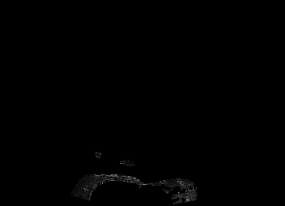


Local Style Transfer
*
20-200 min
Optimization approach
Neural Style Transfer
Augmented Style Loss
Local Style Transfer
Average style in feature space
Masking in the image space:
Mask content with its corresponding masks
Apply NST on the masked content (i.e. locally)
Repeat for all the considered labels
Sum up the local results
$$×$$
NST
Learning approach
Perceptual Loss network
Noise Injection
Average style in feature space
…
+ … +
$$×$$
NST
* 3000 iterations on Titan X, timing depends on the amount of masks (1 to 10)

Slide 9
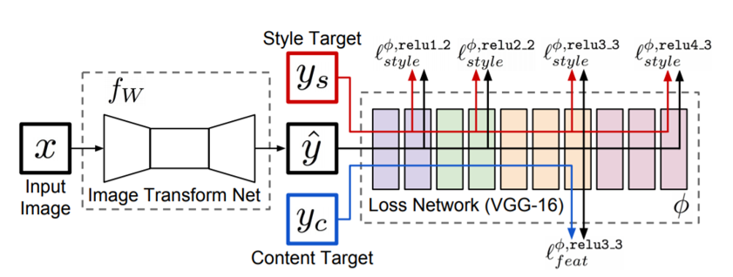
Perceptual Loss Network
1 sec
Optimization approach
Neural Style Transfer
Augmented Style Loss
Local Style Transfer
Average style in feature space
Image Transform Network:
Encoder-decoder CNN with 1.6M parameters
Trained with perceptual loss calculated over features extracted from VGG-19
Real-time style transfer
Addition of noise layers in the decoding section
Learning approach
Perceptual Loss network ^{[3]}
Noise Injection ^{[4]}
Average style in feature space

Slide 10
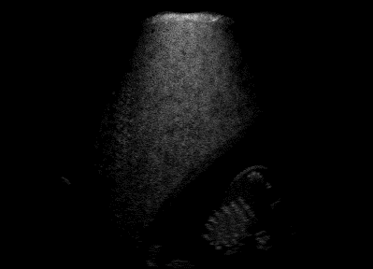
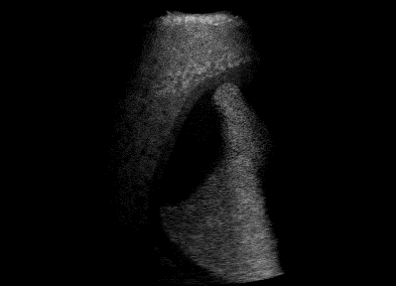
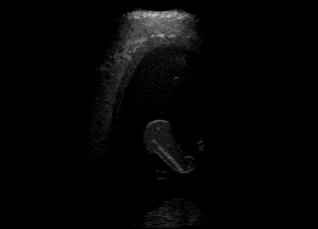
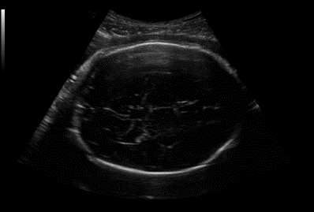
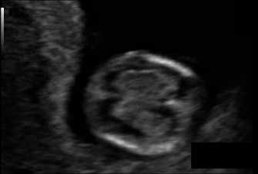

Average Style
*
20 min
Optimization approach
Neural Style Transfer
Augmented Style Loss
Local Style Transfer
Average style in feature space
Several style images in the HQ and clinical datasets:
…
…
Learning approach
Perceptual Loss network
Noise layers
Average style in feature space
Average style:
Extract features from style images
Average over feature space
Use it as target for NST optimization / training
* 3000 iterations on Titan X, excluding average style creation

Slide 11
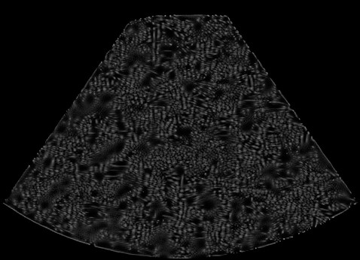

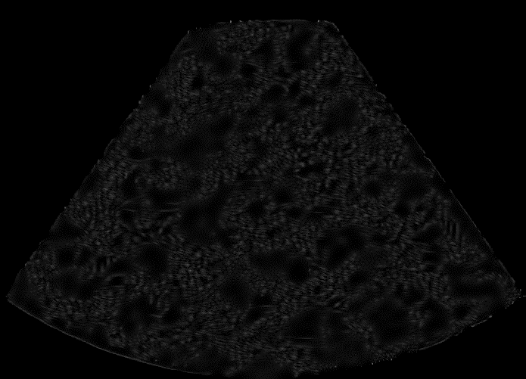

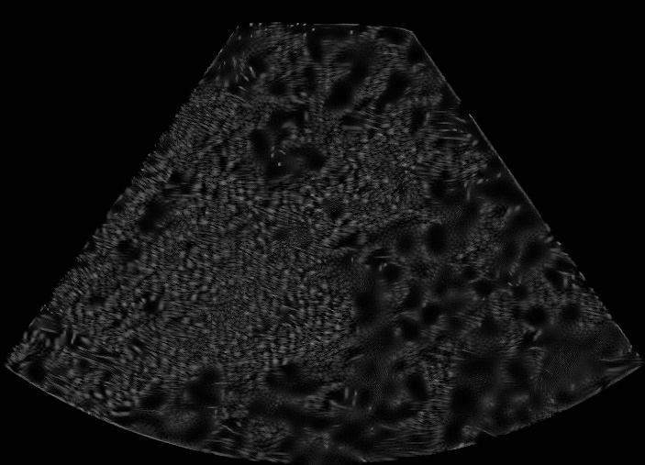
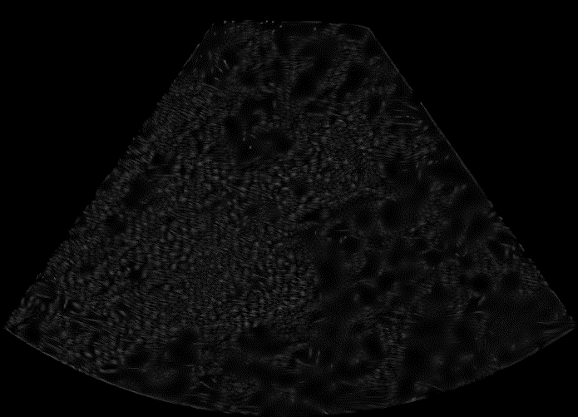
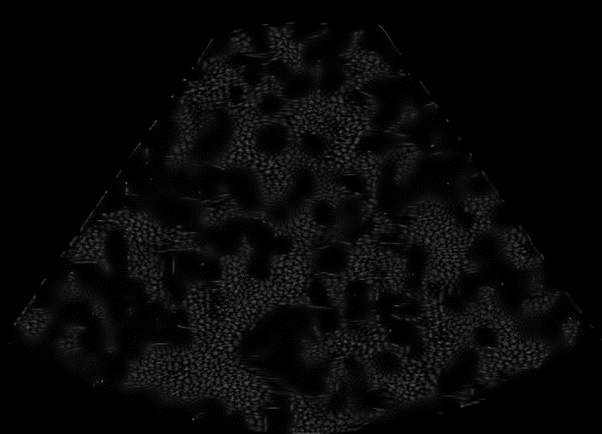
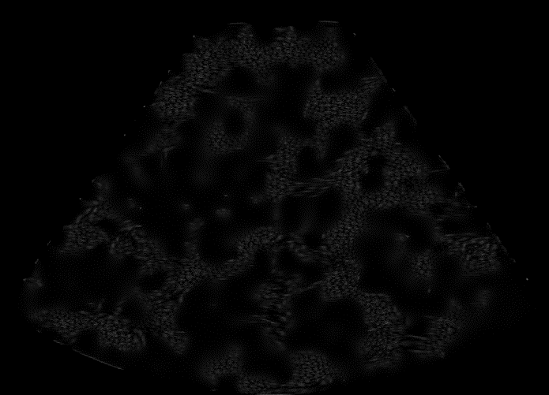
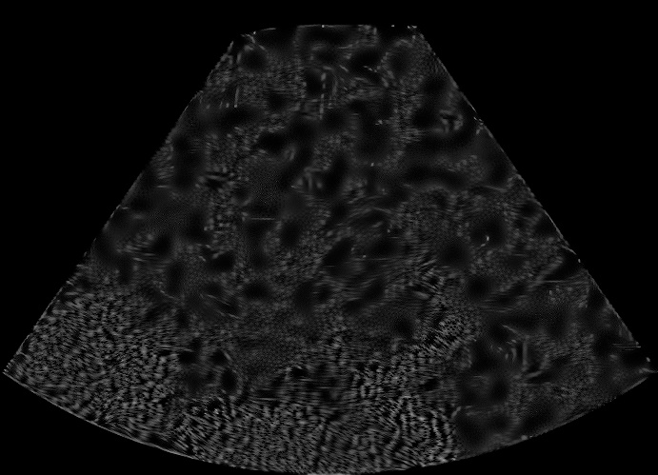
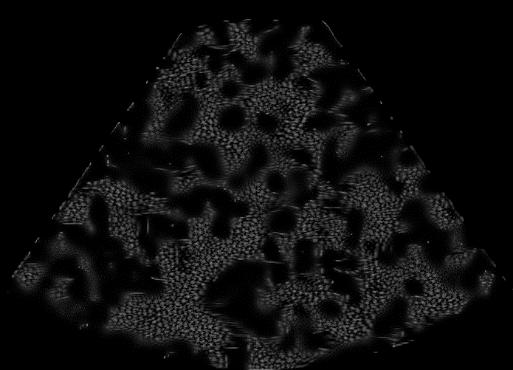

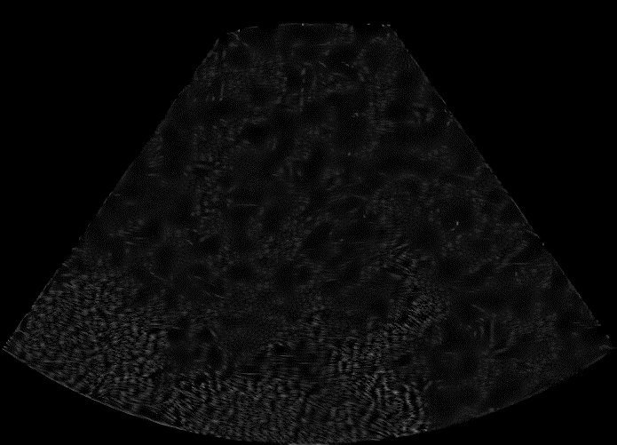
Style Analysis – Dependence from Style Image
Image
LQ Style
HQ Style
HQ+ Style

Slide 12
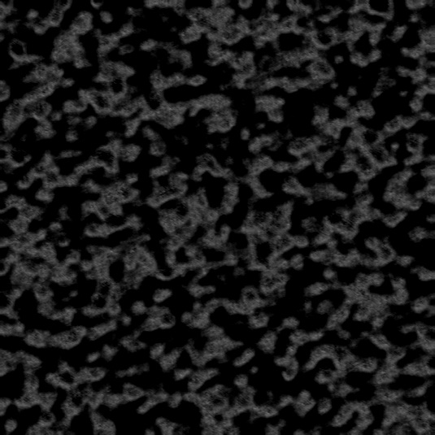
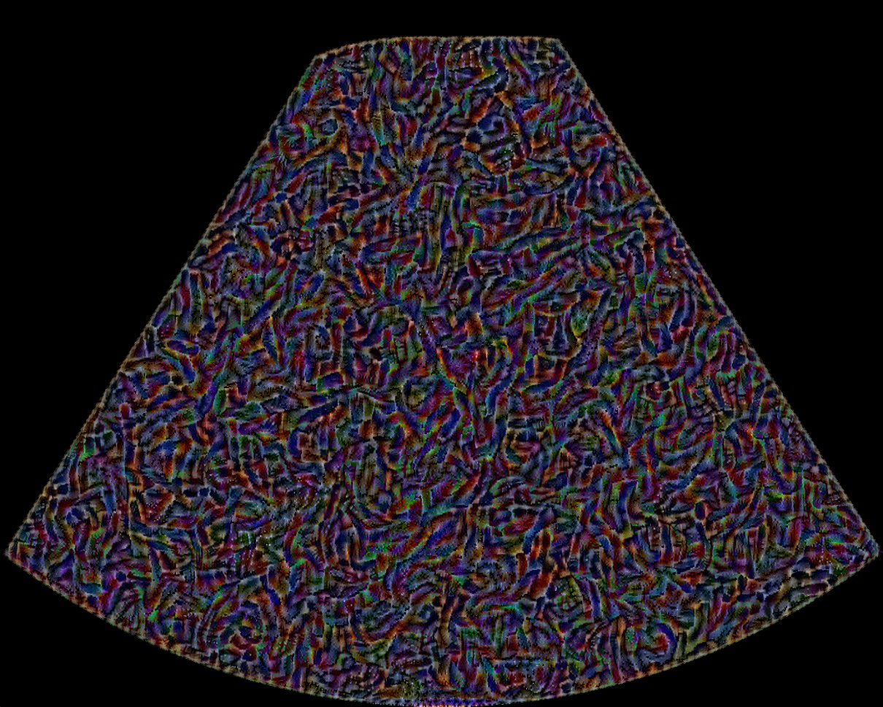
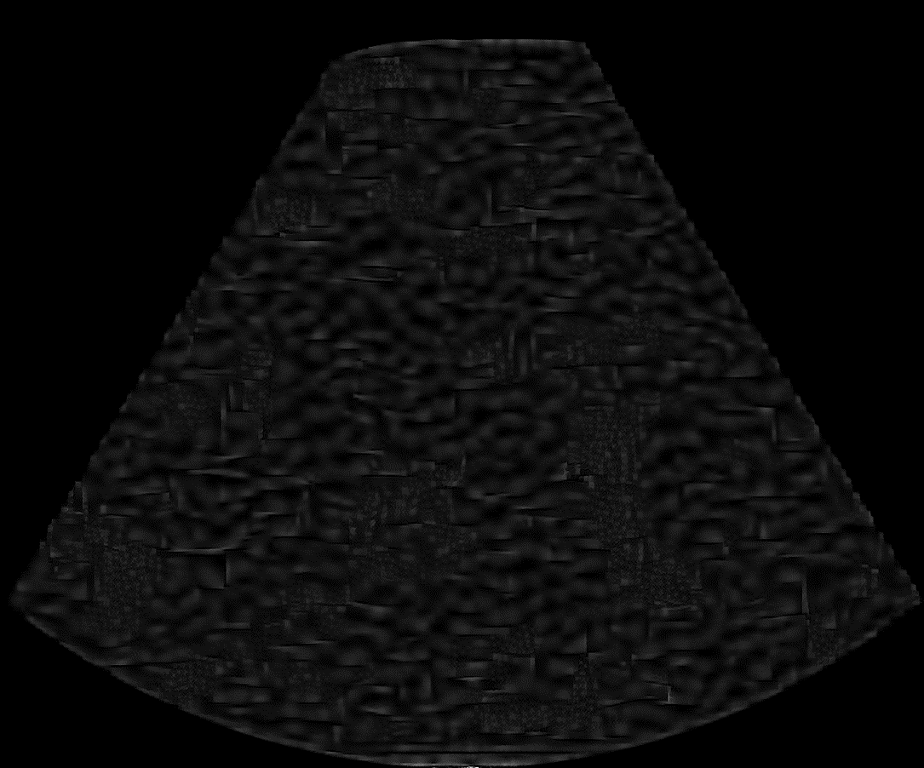
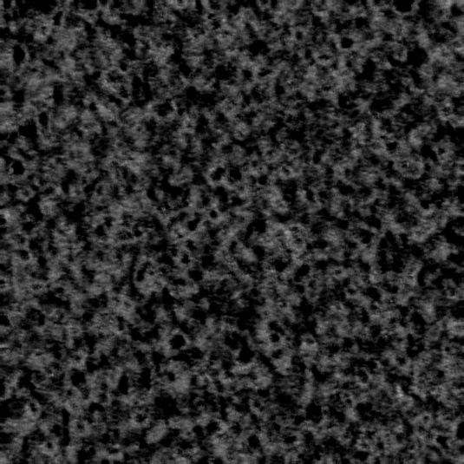
Style Analysis – Comparison
LQ (optimization)
HQ (optimization)
HQ (learning)
Kandinsky
Clinical (optimization)
Clinical (learning)

Slide 13


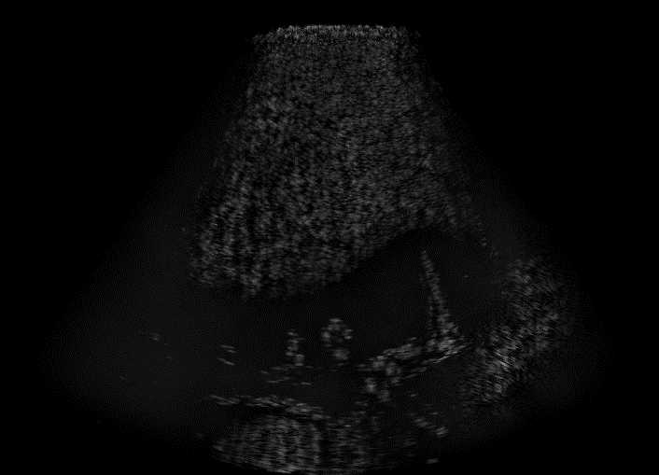
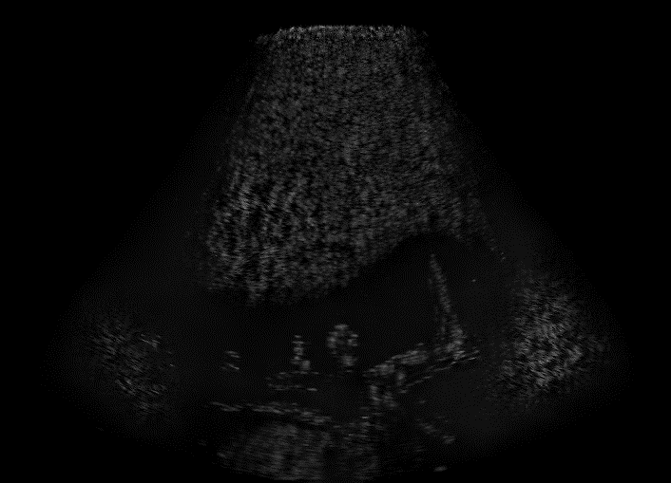

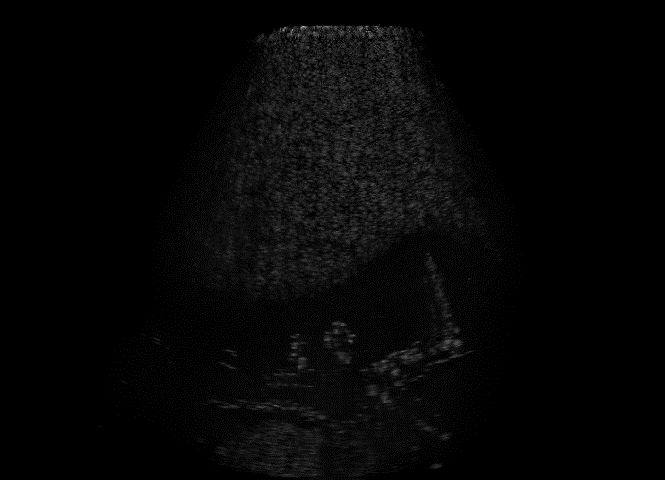
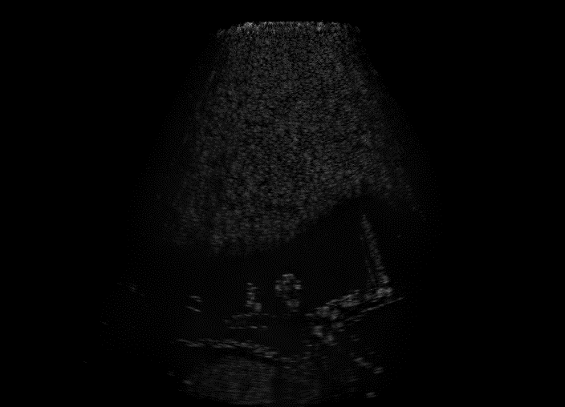
Low-Quality to High-Quality – Optimization Approach
Content
Unpaired style
StyleLoss
StyleLoss+
SSIM=50.5%
PSNR=22.56
SSIM=50.9%
PSNR=21.86
Content
Paired style
StyleLoss
StyleLoss+
SSIM=63.5%
PSNR=23.72
SSIM=63.9%
PSNR=23.77

Slide 14
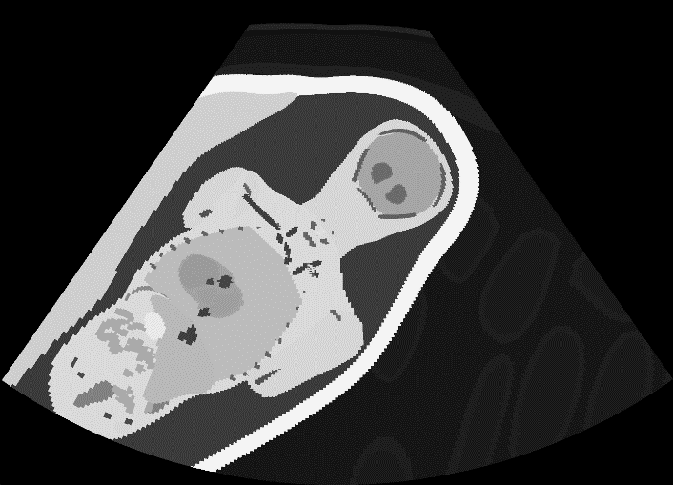
Low-Quality to High-Quality – Optimization Approach
Content
Unpaired style
StyleLoss
StyleLoss+
Segmentation
Segmentation
Target (paired style)

Slide 15

Low-Quality to High-Quality – Optimization Approach
Content
StyleLoss
StyleLoss+
SSIM=50.5%
PSNR=22.56
SSIM=50.9%
PSNR=21.86
Style
Local NST
Average Style
SSIM=48.8%
PSNR=22.19
SSIM=54.8%
PSNR=23.19

Slide 16



Low-Quality to High-Quality – Learning Approach
Content
Image Transform Net
Noise Injection
Average Style
Style
SSIM=74.8%
PSNR=27.29
SSIM=71.8%
PSNR=25.20
SSIM=73.6%
PSNR=26.20
Test Set | Image Transform Net | Noise Injection | Average Style
SSIM | 71.4% | 68.4% | 71.7%
PSNR | 25.78 | 23.87 | 25.96
FID | 148 | 135 | 139

Slide 17




Segmentation to High-Quality
Content
StyleLoss
StyleLoss+
SSIM=46.2%
PSNR=19.21
SSIM=45.2%
PSNR=18.86
Style
Image Transform Net
Noise Injection
SSIM=42.2%
PSNR=17.37
FID=308
SSIM=42.3%
PSNR=17.49
FID=319

Slide 18

High-Quality to Clinical – Optimization Approach
Content
StyleLoss
StyleLoss+
Style
Average Style

Slide 19



High-Quality to Clinical – Learning Approach
Content
Image Transform Net
Noise Injection
Average Style
Style
Test Set | Image Transform Net | Noise Injection | Average Style
FID | 269 | 250 | 230

Slide 20
Conclusion
The learning approach outperforms the optimization approach:
Better interpretation of the styles
Remarkably better scores: SSIM +20%, PSNR +3dB (on average)
Visually better outcomes
Better run-time: real-time vs. 20min per style transfer
Optimization outcomes from paired images are significantly better than from unpaired images
The average style helps to make the outcomes more independent from the chosen style images.
The segmentation to high-quality task is not satisfying in almost any case.
Other tasks lead to scores and outcomes which are a good starting point for further research.

Slide 21
Thanks for your attention!
Menini Davide
dmenini@student.ethz.ch

Slide 22
Bibliography
[1] Leon A. Gatys, Alexander S. Ecker, and Matthias Bethge. A neural algorithm of artistic style, 2015.
[2] Justin Johnson, Alexandre Alahi, and Li Fei-Fei. Perceptual losses for real-time style transferand super-resolution, 2016.
[3] Fujun Luan, Sylvain Paris, Eli Shechtman, and Kavita Bala. Deep photo style transfer, 2017.
[4] Tero Karras, Samuli Laine, and Timo Aila. A style-based generator architecture for generative adversarial networks, 2018.
[5] Oliver Mattausch, Maxim Makhinya, and Orcun Goksel. Realistic ultrasound simulation of complex surface models using interactive monte-carlo path tracing, 2018.
[6] T.L.A. van den Heuvel, Dagmar de Bruijn, Chris L. de Korte, and Bram van Ginneken. Automated measurement of fetal head circumference, 2018.

